Slide 1
MODULE 4 CHAPTER 8 BAYESIAN LEARNING

Slide 2
8.1 INTRODUCTION TO PROBABILITY-BASED LEARNING
Probability-based learning is one of the most important practical learning methods which combines prior knowledge or prior probabilities with observed data.
Probabilistic learning uses the concept of probability theory that describes how to model randomness, uncertainty, and noise to predict future events.
It is a tool for modelling large datasets and uses Bayes rule to infer unknown quantities, predict and learn from data.

Slide 3
In a probabilistic model, randomness plays a major role which gives probability distribution a solution, while in a deterministic model there is no randomness and hence it exhibits the same initial conditions every time the model is run and is likely to get a single possible outcome as the solution.
Bayesian learning differs from probabilistic learning as it uses subjective probabilities (i.e., probability that is based on an individual’s belief or interpretation about the outcome of an event and it can change over time) to infer parameters of a model.
Two practical learning algorithms called Naïve Bayes learning and Bayesian Belief Network (BBN) form the major part of Bayesian learning. These algorithms use prior probabilities and apply Bayes rule to infer useful information.

Slide 4
Bayesian Learning is a learning method that describes and represents knowledge in an uncertain domain and provides a way to reason about this knowledge using probability measure.
It uses Bayes theorem to infer the unknown parameters of a model.
Bayesian inference is useful in many applications which involve reasoning and diagnosis such as game theory, medicine, etc. Bayesian inference is much more powerful in handling missing data and for estimating any uncertainty in predictions.

Slide 5
For Understanding
The prior probability is the probability assigned to an event before the arrival of some information that makes it necessary to revise the assigned probability.
The revision of the prior is carried out using Bayes' rule. The new probability assigned to the event after the revision is called posterior probability.
What is prior probability in Naive Bayes?
The probability of each class before any characteristics are observed is known as the prior probability in the Naive Bayes method
Posterior probability = prior probability + new data

Slide 6
For Understanding
What is likelihood probability in Machine Learning with example?
In simple words, as the name suggests, the likelihood is a function that tells us how likely the specific data point suits the existing data distribution.
For example.
Suppose there are two data points in the dataset. The likelihood of the first data point is greater than the second

Slide 7
For Understanding
Examples of Probability and Likelihood
Examples 1 – Coin Toss
In the context of coin tosses, likelihood and probability represent different aspects of the same experiment.
The likelihood refers to the probability of observing a specific outcome given a particular model or hypothesis.
On the other hand, probability represents the long-term frequency of an event occurring over multiple trials.

Slide 8
For Understanding
To recap: probability is generally something we consider when we have a model with a fixed set of parameters and we are interested in the types of data that might be generated.
Conversely, likelihood comes into play when we have already observed data and we want to examine how likely certain model parameters are.
The distinction between probability and likelihood is fundamentally important: Probability attaches to possible results; likelihood attaches to hypotheses.

Slide 9
For Understanding
What is Probability?
Probability is a measure of the likelihood that an event will actually occur based on information or assumptions that are currently known.
The probability of the event is commonly stated as a number between 0 and 1, where 0 indicates impossibility and 1 indicates inevitability.
To determine probability, use the following formula −
Probability=Numberoffavorableoutcomes/Totalnumberofoutcomes
For instance, the probability of getting heads when flipping a fair coin is 0.5 because there are two possible outcomes (heads or tails), and each outcome has an equal likelihood of occurring.
Probability is used to describe the likelihood of events based on assumptions or to make predictions about the future.

Slide 10
For Understanding
Probability is used to make predictions about future events, whereas likelihood is used to estimate unknown parameters based on seen evidence.

Slide 11
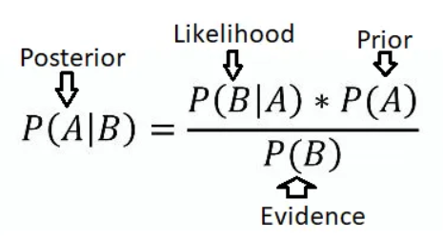

Slide 12
8.2 FUNDAMENTALS OF BAYES THEOREM
Naïve Bayes Model relies on Bayes theorem that works on the principle of three kinds of probabilities called prior probability, likelihood probability, and posterior probability.
Prior Probability It is the general probability of an uncertain event before an observation is seen or some evidence is collected. It is the initial probability that is believed before any new information is collected.
Likelihood Probability Likelihood probability is the relative probability of the observation occurring for each class or the sampling density for the evidence given the hypothesis. It is stated as P (Evidence | Hypothesis), which denotes the likeliness of the occurrence of the evidence given the parameters.
Posterior Probability It is the updated or revised probability of an event taking into account the observations from the training data. P (Hypothesis | Evidence) is the posterior distribution representing the belief about the hypothesis, given the evidence from the training data. Therefore,
Posterior probability = prior probability + new evidence

Slide 13
8.3 CLASSIFICATION USING BAYES MODEL
Naïve Bayes Classification models work on the principle of Bayes theorem.
Bayes’ rule is a mathematical formula used to determine the posterior probability, given prior probabilities of events.
Generally, Bayes theorem is used to select the most probable hypothesis from data, considering both prior knowledge and posterior distributions. It is based on the calculation of the posterior probability and is stated as:
P (Hypothesis h | Evidence E)
where, Hypothesis h is the target class to be classified and Evidence E is the given test instance.

Slide 14
P (Hypothesis h| Evidence E) is calculated from the prior probability P (Hypothesis h), the likelihood probability P (Evidence E |Hypothesis h) and the marginal probability P (Evidence E).
It can be written as:
where, P (Hypothesis h) is the prior probability of the hypothesis h without observing the training data or considering any evidence.
It denotes the prior belief or the initial probability that the hypothesis h is correct. P (Evidence E) is the prior probability of the evidence E from the training dataset without any knowledge of which hypothesis holds. It is also called the marginal probability.

Slide 15
P (Evidence E | Hypothesis h) is the prior probability of Evidence E given Hypothesis h.
It is the likelihood probability of the Evidence E after observing the training data that the hypothesis h is correct.
P (Hypothesis h | Evidence E) is the posterior probability of Hypothesis h given Evidence E.
It is the probability of the hypothesis h after observing the training data that the evidence E is correct.
In other words, by the equation of Bayes Eq. (8.1), one can observe that:
Posterior Probability α Prior Probability × Likelihood Probability

Slide 16
Bayes theorem helps in calculating the posterior probability for a number of hypotheses, from which the hypothesis with the highest probability can be selected.
This selection of the most probable hypothesis from a set of hypotheses is formally defined as Maximum A Posteriori (MAP) Hypothesis

Slide 17
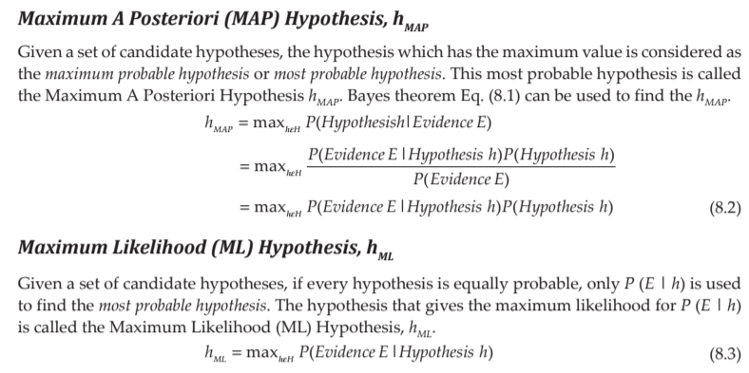

Slide 18
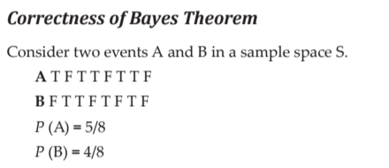
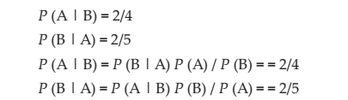

Slide 19
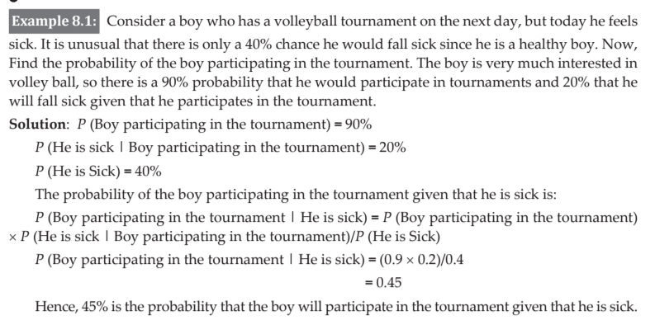

Slide 20
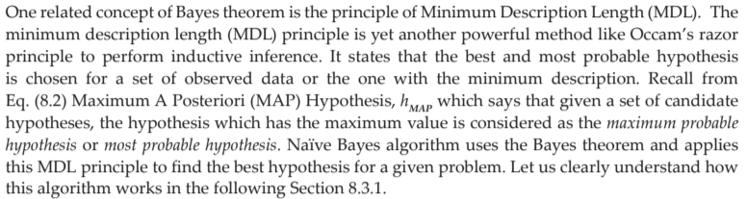

Slide 21
What is Naive Bayes Classifier?
Naive Bayes classifier is a probabilistic machine learning model based on Bayes’ theorem. It assumes independence between features and calculates the probability of a given input belonging to a particular class. It’s widely used in text classification, spam filtering, and recommendation systems.

Slide 22
8.3.1 NAÏVE BAYES ALGORITHM
It is a supervised binary class or multi class classification algorithm that works on the principle of Bayes theorem.
There is a family of Naïve Bayes classifiers based on a common principle.
These algorithms classify for datasets whose features are independent and each feature is assumed to be given equal weightage.
It particularly works for a large dataset and is very fast. It is one of the most effective and simple classification algorithms.
This algorithm considers all features to be independent of each other even though they are individually dependent on the classified object.
Each of the features contributes a probability value independently during classification and hence this algorithm is called as Naïve algorithm. Some important applications of these algorithms are text classification, recommendation system and face recognition.

Slide 23
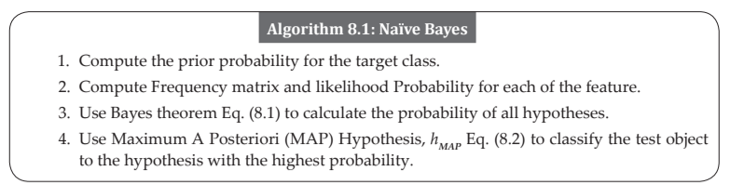
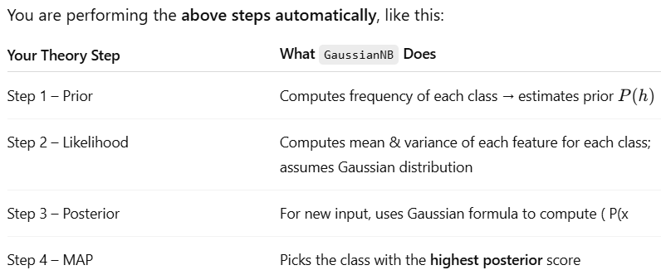

Slide 24
# Predict on test set
y_pred = nb_classifier.predict(X_test)
#It calculates posterior probabilities for each class and assigns the class with the highest one — that’s your MAP classifier in action.

Slide 25
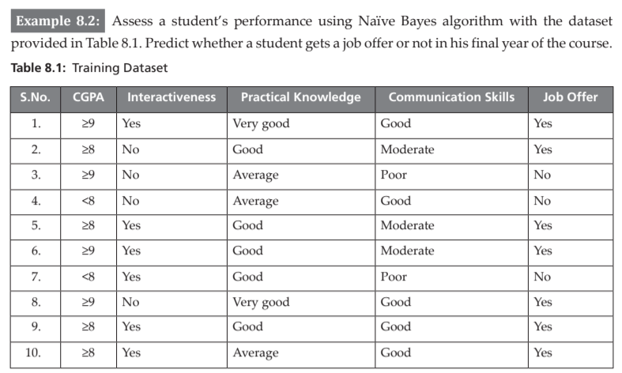

Slide 26
Solution: The training dataset T consists of 10 data instances with attributes such as ‘CGPA’, ‘Interactiveness’, ‘Practical Knowledge’ and ‘Communication Skills’ as shown in Table 8.1.
The target variable is Job Offer which is classified as Yes or No for a candidate student.
Step 1: Compute the prior probability for the target feature ‘Job Offer’. The target feature ‘Job Offer’ has two classes, ‘Yes’ and ‘No’.
It is a binary classification problem.
Given a student instance, we need to classify whether ‘Job Offer = Yes’ or ‘Job Offer = No’.
From the training dataset, we observe that the frequency or the number of instances with ‘Job Offer = Yes’ is 7 and ‘Job Offer = No’ is 3.

Slide 27
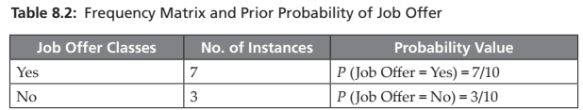
The prior probability for the target feature is calculated by dividing the number of instances belonging to a particular target class by the total number of instances.
Hence, the prior probability for ‘Job Offer = Yes’ is 7/10 and ‘Job Offer = No’ is 3/10 as shown in Table 8.2.

Slide 28
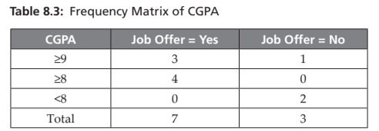
Step 2: Compute Frequency matrix and Likelihood Probability for each of the feature. Step 2(a): Feature – CGPA Table 8.3 shows the frequency matrix for the feature CGPA.

Slide 29
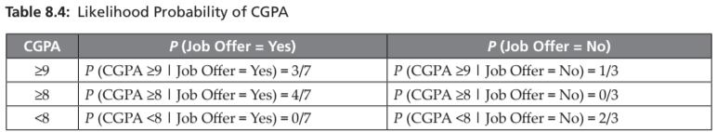
Table 8.4 shows how the likelihood probability is calculated for CGPA using conditional probability.

Slide 30
As explained earlier the Likelihood probability is stated as the sampling density for the evidence given the hypothesis.
It is denoted as P (Evidence | Hypothesis), which says how likely is the occurrence of the evidence given the parameters.
It is calculated as the number of instances of each attribute value and for a given class value divided by the number of instances with that class value.
For example P (CGPA ≥9 | Job Offer = Yes) denotes the number of instances with ‘CGPA ≥9’ and ‘Job Offer = Yes’ divided by the total number of instances with ‘Job Offer = Yes’.
From the Table 8.3 Frequency Matrix of CGPA, number of instances with ‘CGPA ≥9’ and ‘Job Offer = Yes’ is 3. The total number of instances with ‘Job Offer = Yes’ is 7. Hence, P (CGPA ≥9 | Job Offer = Yes) = 3/7.
Similarly, the Likelihood probability is calculated for all attribute values of feature CGPA.

Slide 31
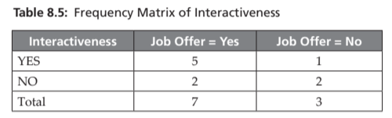
Step 2(b): Feature – Interactiveness Table 8.5 shows the frequency matrix for the feature Interactiveness.

Slide 32
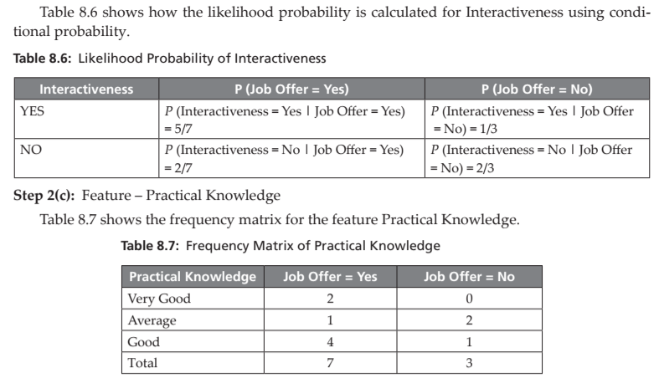

Slide 33
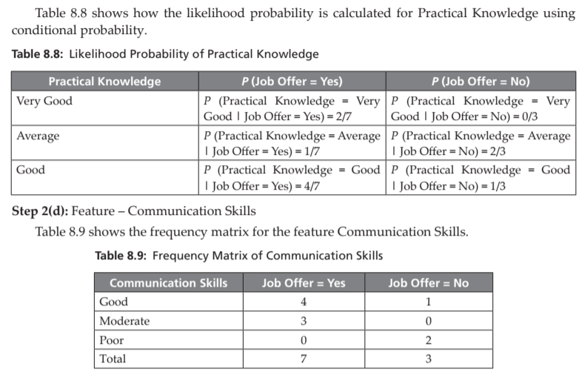

Slide 34
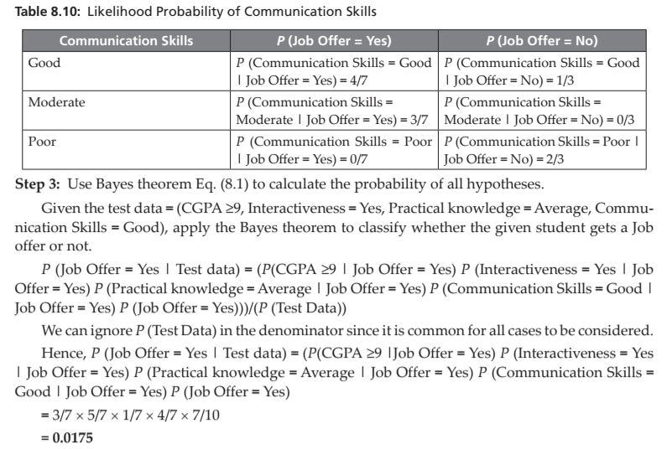

Slide 35
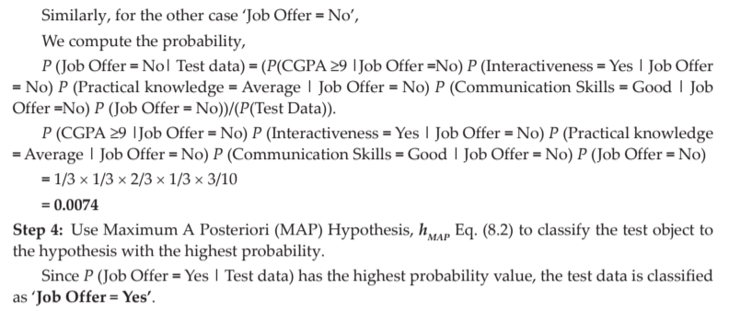

Slide 36
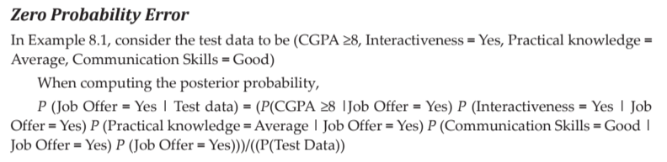
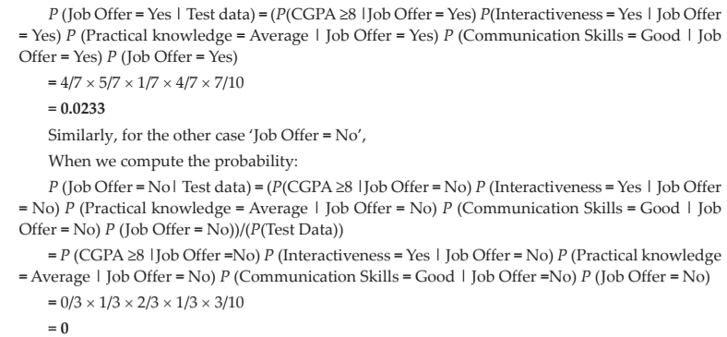

Slide 37
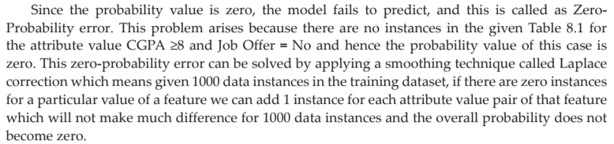

Slide 38
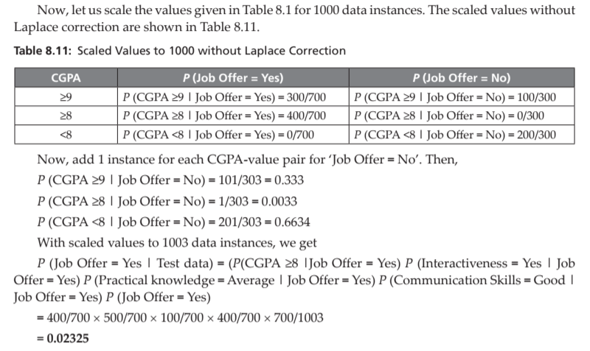

Slide 39
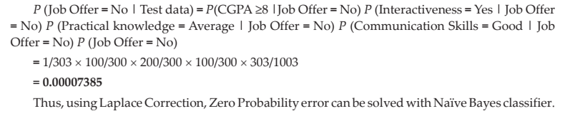

Slide 40
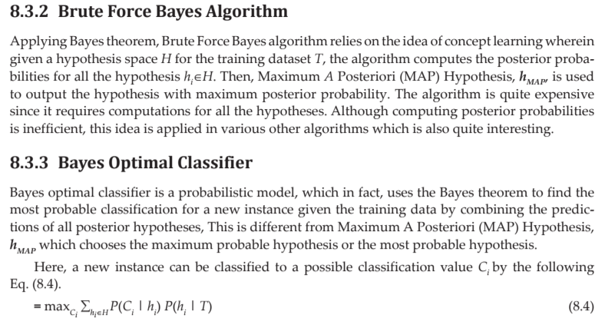


Slide 41
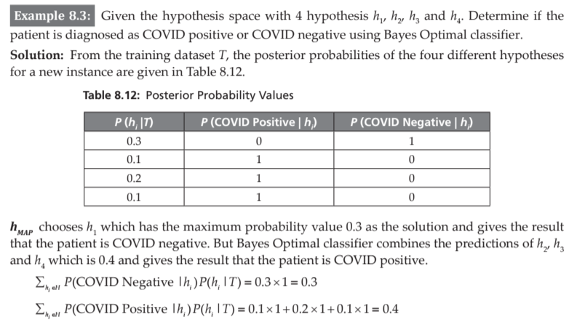


Slide 42
8.3.4 Gibbs Algorithm
The main drawback of Bayes optimal classifier is that it computes the posterior probability for all hypotheses in the hypothesis space and then combines the predictions to classify a new instance.
Gibbs algorithm is a sampling technique which randomly selects a hypothesis from the hypothesis space according to the posterior probability distribution and classifies a new instance.
It is found that the prediction error occurs twice with the Gibbs algorithm when compared to Bayes Optimal classifier.

Slide 43
8.4 NAÏVE BAYES ALGORITHM FOR CONTINUOUS ATTRIBUTES
There are two ways to predict with Naive Bayes algorithm for continuous attributes:
1. Discretize continuous feature to discrete feature.
2. Apply Normal or Gaussian distribution for continuous feature.
Gaussian Naive Bayes Algorithm In Gaussian Naive Bayes, the values of continuous features are assumed to be sampled from a Gaussian distribution.

Slide 44
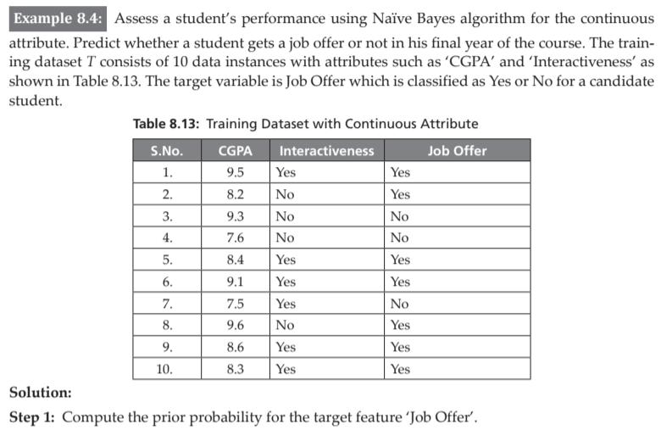
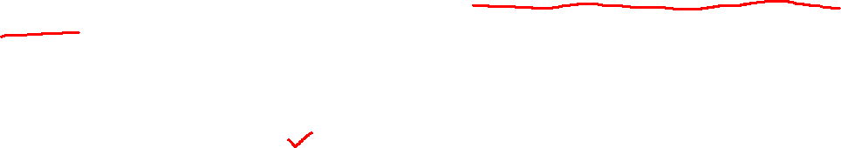

Slide 45
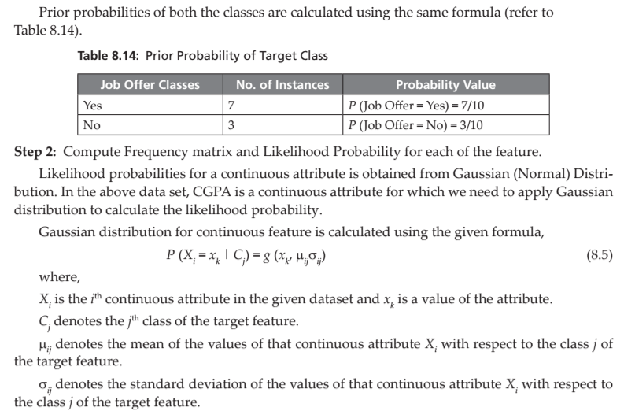


Slide 46
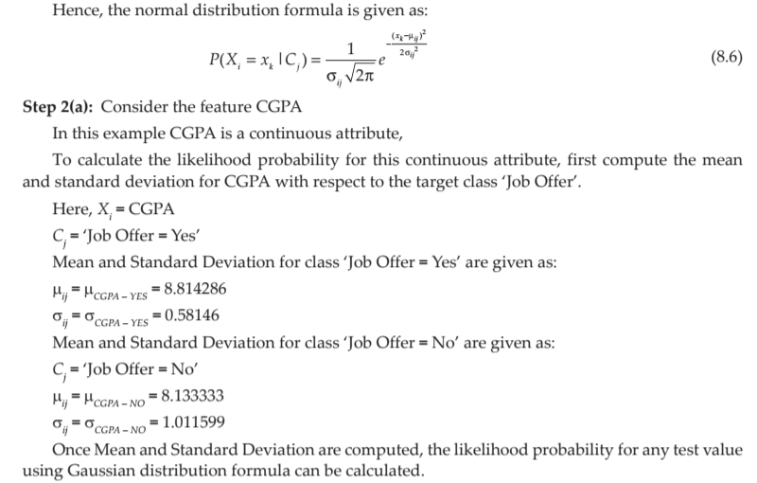


Slide 47
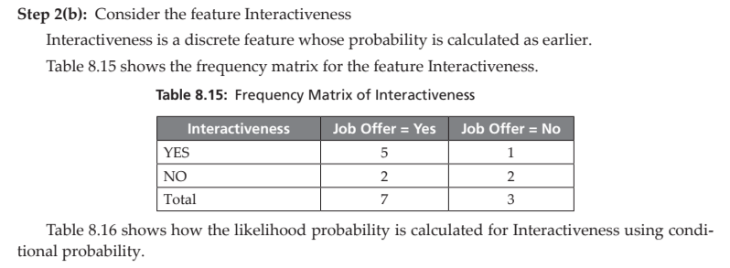


Slide 48
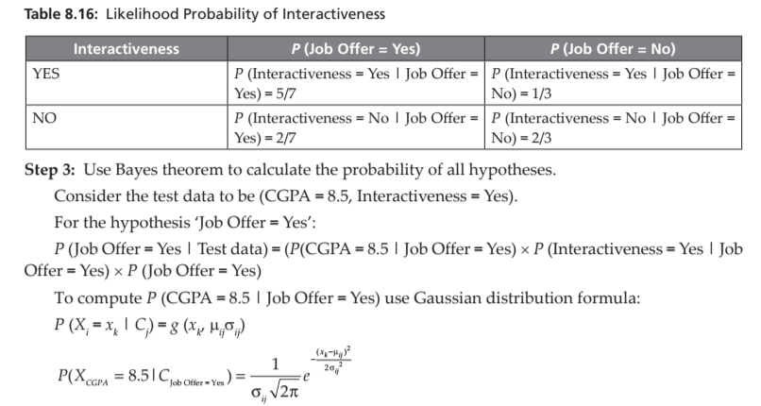
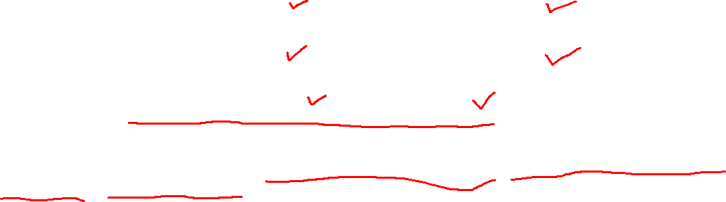

Slide 49
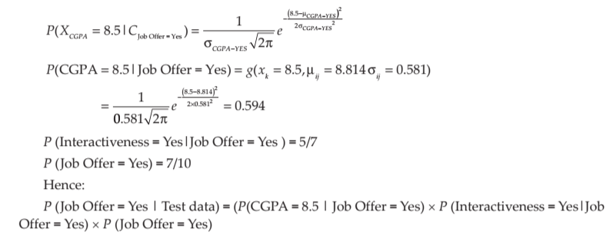


Slide 50
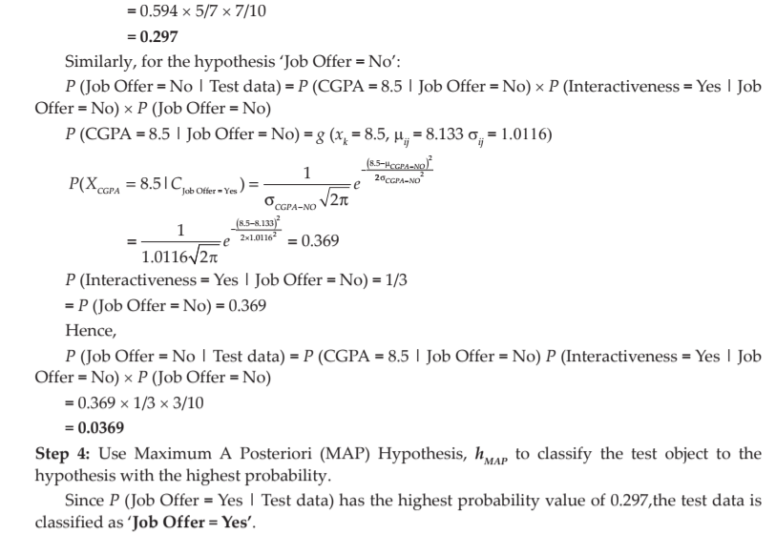

Slide 51
Thank You

